Slide 1

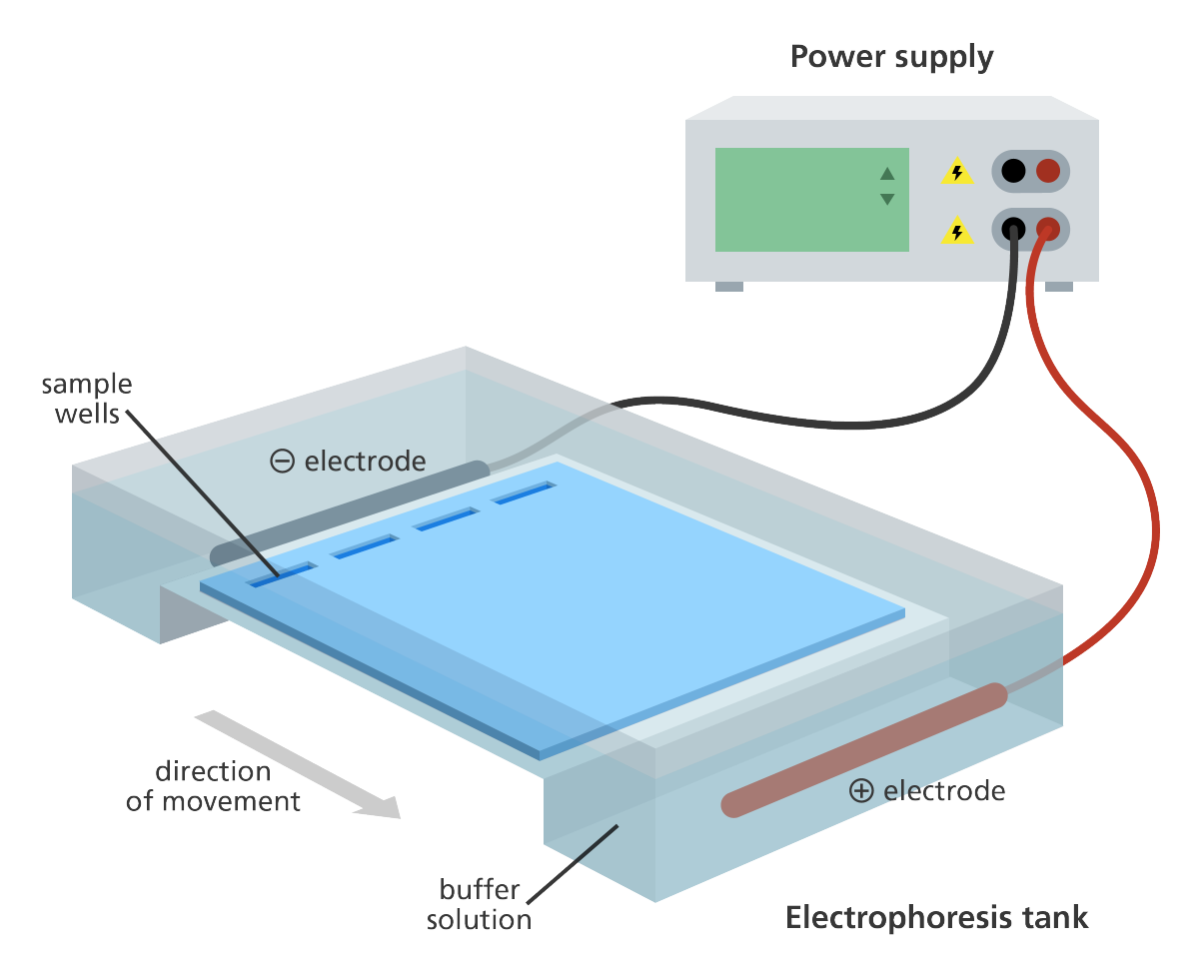
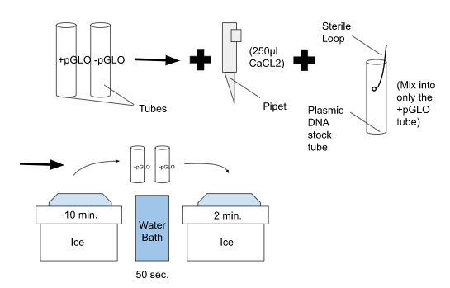
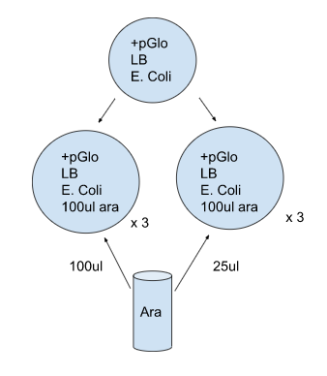
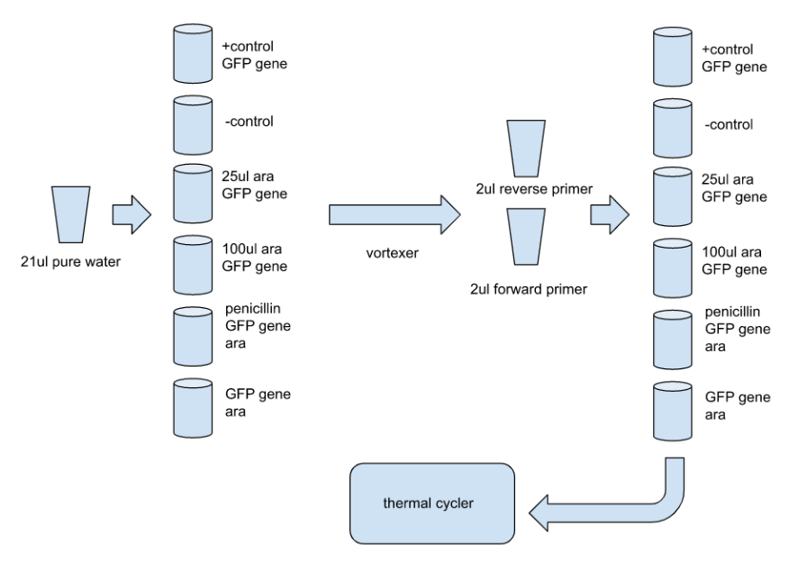
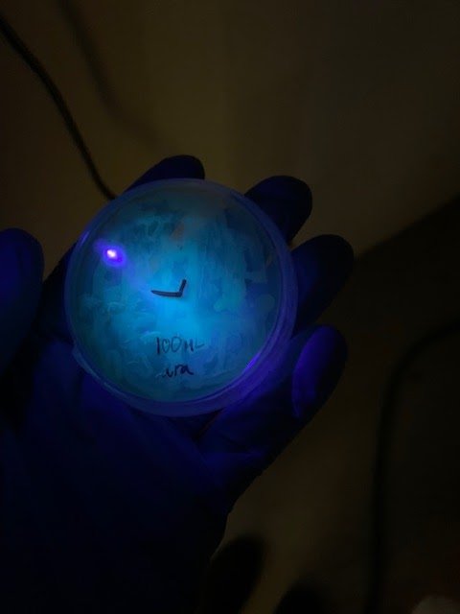
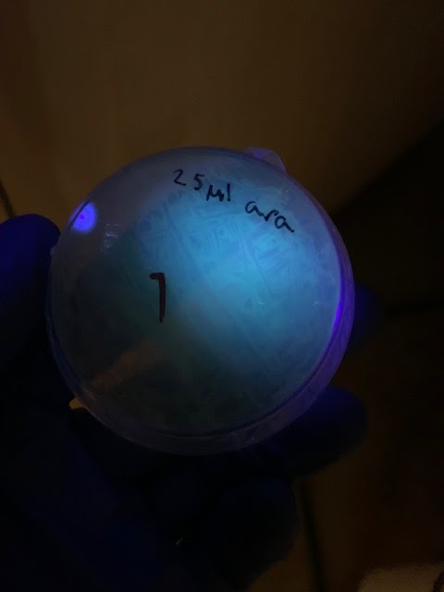
Will the Green Fluorescent Gene Persist in Bacterial Plasmids After Gene Transformation?
Ryan Ignatowicz & Henry Kuerbis Biology 101 Fall 2022
Background:
We are interested in the product of the green fluorescent gene (GFP) gene. The GFP gene is found in illuminating jellyfish, but for our purposes was spliced into the pGLO plasmid. Plasmids are small circular DNA strands, typically found in bacteria. Normally bacteria obtain environmental DNA through transformation but will instead be spliced for our efficiency. The GFP is responsible for making a green fluorescent protein and resides alongside the bla gene in our plasmids. The bla gene confers antibiotic resistance. To identify whether or not a bacteria sample has GFP, it should glow green under UV light. Within our specific plasmids, an enzyme that breaks down the sugar arabinose had its coding genes, an operon, replaced with GFP. An operon are sets of genes controlled by a promoter sequence. In order for a bacteria to now glow, arabinose must be present for its related protein, araC, to allow an mRNA transcription of GFP to create its glowing protein. We observed the growth different combinations of E. Coli, ampicillin, and pGLO to determine the efficacy of the plasmid intake. It involved heat shocking to denature the bacteria as well as a 24-hour incubation period for growth. Next, in search of arabinose’s effect on bacterial plasmids, we ran another experiment giving a different amount of arabinose to three samples each. We used bacteria already found to express the GFP gene from our previous transformation experiment to ensure all samples would glow. Given that arabinose triggers the araC protein to allow mRNA to transcribe the new operon from the pGLO plasmid and cause the glowing effect, more arabinose should hypothetically cause the bacteria to glow brighter.
Methods:
Bacterial Transformation
Two tubes held a CaCl2 and E.Coli mixture, with one having pGLO plasmids as well. The tubes were heat shocked to ensure the bacteria took in the plasmids.
Each mixture was moved into 4 agar slides, respectively. They were labeled based on which pGLO mixture they were receiving and if they have ampicillin, arabinose, or both.
Figure 1: Transformation Process
Experimental Design
Our experimental design centered around the question: Will higher levels of arabinose cause the transformed bacteria to glow more? To test this, two treatments were prescribed to three samples each. Using a sterilized loop, all 6 LB agar plates were coated with an extracted E. Coli that has +pGLO plasmids from our last tranformation experiment. 25μl of arabinose was added to the three plates with a pipette, while 100μl was added to the other three. The plates were then stacked and incubated for at least 24 hours.
Figure 2: Arabinose Experiment Process
PCR
The contents of the PCR tubes are: Two GFP gene primers (forward and reverse), Taq Polymerase, Adenine, guanine, thymine, and cytosine, and Buffers.
The tubes’ contents were denatured, then the primers were annealed to the DNA.Taq polymerase then adds new nucleotides to 3’ ends. The cycler heats back up to repeat the process 30 times.
Gel Electrophoresis
Gel electrophoresis is the final step in observing a PCR product of interest. Gel electrophoresis is a technique used to sort a sample of DNA by size. Scientists compare different samples of DNA using gel electrophoresis to identify similarities based on DNA strand length between the samples. Samples of DNA are added to wells at one end of the gel, an electric current is passed through the gel creating an electric field with an negative end at the wells and a positive end at the opposite side of the well. The DNA in the wells is negatively charged due to its phosphate group, therefore it is pulled toward the opposite positive end of the gel. Shorter strands of DNA more easily pass through the gel and approach the opposite end of the gel while longer ones remain closer to the wells. After the electric current is passed through the gel and the DNA is sorted by size, scientists are able to observe the sorted DNA under a UV light because of the GelRed dye in the gel. A molecular weight ruler is then used to determine the number of base pairs by comparing the length of the DNA samples to other known DNA strands.
Figure 4: Gel Electrophoresis (Source: GA International 2019)
PCR & Gel Electrophoresis
Discussion:
Bacterial Transformation
Gene transformation refers to the alteration of genetic information within a cell, resulting from the direct addition and subsequent uptake of a new gene. In our case E. Coli bacteria were transformed with the pGLO plasmid. Results showed that bacteria samples were able to take in the plasmids by reason of their growth and glow in the presence of arabinose and ampicillin. Because our plasmids have the resistant bla gene, bacteria containing it should be the only surviving member of our samples that contained ampicillin. Being able to express the GFP gene substantiates the transformation methodology, as the use of heat shocking proved effective in defusing new code into the bacterial genome.
Experimental Design
In testing arabinose’s effect on GFP’s expression, we found that there was not a significant difference between the brightness in the 25μl and 100μl samples. The likely cause of this lack of difference resides in how operon activators work. Proteins like the araC can only hold one particle of arabinose at a time to trigger the operon. Both the 25μl and 100μl arabinose samples likely exceeded the limited amount of araC in each plate, meaning the excess has no effect on the brightness as they are not being used. Gene regulation is also needed in order to conserve energy because not all genes are needed at all times. Therefore, the araC will not overwork itself for the sake of extra arabinose in its environment when it can function properly with less. A potential error in determining brightness comes from the subjectivity of our measurements. Lacking a light meter, we used observational comparison, which could vary results depending on the measurer.
PCR & Gel Electrophoresis
The polymerase chain reaction (PCR) is a useful tool in artificial DNA duplication. The reaction takes place in a tube and uses primers to identify a specific section of DNA before it copies it millions of times just as DNA replication would do. A forward and reverse primer, designed with 22 specific nucleotide sequences, attach to their respective ends of the DNA strand to synthesize a new strand. Using longer primers will ensure specificity that they will connect to the right base pairs of interest.
Future of Study
After investigating how bacteria can undergo gene transformation, a related study comparing the efficiency of our denaturing process to that of nanoparticle-mediated gene transformation could be beneficial. Nanoparticle-mediated gene transformation is a process which inserts DNA or RNA into the plants’ genomes with the use of magnets to pull nanoparticles into the pollen (Lv 2020). This method avoids much of the tissue damage caused by other types of DNA transformation and could be beneficial in manipulating genomes to create accelerated crop improvement and survivability (Lv 2020). To compare both methods, we could test the potency of a gene like GFP with a similar observable phenotype between two groups of plant cells. The groups would differ in which treatment they undergo: denaturation or nanoparticle-mediation. We hypothesize that denaturation could lead to the breakdown of proteins, which would favor the alternative use of nanoparticles to better maintain cell function during gene transformation. Finding an optimal methodology for plant gene transformation could allow the agricultural industry to flourish with disease resistant crops and accelerated breeding.
Acknowledgements:
Thank you to Thomas Roehl for guiding experimental procedures.
Works Cited
Lv, Z. et al. (2020), Nanoparticle-mediated gene transformation strategies for plant genetic engineering. Plant J., 104: 880-891. https://doi.org/10.1111/tpj.14973
Designed Experiment Hypotheses and Predictions:
Null
If additional arabinose does not impact the proficiency of araC’s operon transcription, then there should be no difference in the glow between the 25μl and 100μl arabinose samples.
Alternate
If the amount of arabinose in the sample is increased, the bacteria will produce a brighter glow because there would be more arabinose present to activate the operons, creating more glow. The sample with 100μ arabinose should glow brighter than the sample with 25μl arabinose.
Prediction
The 100μl samples will glow brighter.
Results:
Bacterial Transformation
Bacteria transformed with the pGLO plasmid expressed the GFP gene and glowed.
Table 1: Bacterial Transformation Results
Plate Contents | Did the bacteria grow? | Did the bacteria glow?
+pGLO LB/ amp | Yes | No
+pGLO LB/ ara/ amp | Yes | Yes
-pGLO LB/ amp | No | No
-pGLO LB | Yes | No
The bacteria transformed with the pGLO plasmid all grew and glowed, expressing the GFP gene as well as the bla antibiotic gene as well. The bla gene allowed for the growth of the sample in ampicillin. Conversely the absence of the plasmid, and therefore bla gene, caused no growth in the sample with ampicillin. Those two samples also did not glow.
Experimental Design
Table 2: Arabinose Experiment Results
Plate Contents | Did the bacteria glow? | Difference in glow compared to other samples?
+pGLO LB/ 25μl ara | Yes | No
+pGLO LB/ 25μl ara | Yes | No
+pGLO LB/ 25μl ara | Yes | No
+pGLO LB/ 100μl ara | Yes | No
+pGLO LB/ 100μl ara | Yes | No
+pGLO LB/ 100μl ara | Yes | No
Results from the gene transformation experiment evince that all bacteria samples should both grow and glow in this test. When testing the brightness of each sample, there was no difference in between the bacteria with 100μl of arabinose and those with 25μl.
Figure 5: Sample Result Examples
Figure 3: PCR Mixture Distribution
100μl of arabinose
25μl Taq Master Mix
25μl of arabinose

